Slide 1

AUTOMOBILE PART MANUFACTURE COMPANY’S DATA MRA PROJECT – MILESTONE 1
BY – DURGESH BHARGAVA
PGPDSBA.O.JULY24.A

Slide 2


CONTENTS
Agenda & Executive Summary
Project Overview & Objective
Problem Statement
Executive Summary
Data Overview
Data Dictionary
Summary Statistics
Assumptions Made About the Data
Exploratory Data Analysis & Insights
Univariate, Bivariate, and Multivariate Analysis (with Visualizations)
Sales Trends: Weekly, Monthly, Quarterly, and Yearly
Sales Distribution Across Categories and Features
Key Inferences Drawn from the Analysis
Customer Segmentation Using RFM Analysis
Introduction to RFM (Recency, Frequency, Monetary)
Tools Used for Analysis (e.g., KNIME)
Parameters Considered and Assumptions Made
Output Snapshot (Table Head)
Workflow Diagram (Insert KNIME Workflow Image)
Segment Insights:
Identification of Top Customers
Customers at Risk of Churning
Lost Customers
Loyal Customers

Slide 3
AGENDA:-
01
Agenda & Executive Summary of the data
02
Exploratory analysis and insights
03
RFM analysis for customer segmentation
04
Identification of customers based on different parameters
05
Recommendations

Slide 4
Agenda & Executive Summary of the data
Problem statement
About Data (Info, Shape, Summary Stats, your assumptions about data)

Slide 5
Problem statement
An automobile parts manufacturing company has accumulated transaction data over a span of three years. Lacking an internal data science team, they have brought you on board as a consultant. Your role is to leverage your data science expertise to uncover meaningful insights about their data and customer behavior.

Slide 6
Executive Summary:
Project Summary
Data: Last 3 years of customer transactions
Dataset Size: 20 columns, 2,747 rows
Data Quality: No missing or duplicate values; a few outliers in some columns
Objective
Identify customer buying patterns
Recommend personalized marketing strategies for different customer segments
Approach
Performed Exploratory Data Analysis (EDA) to find key sales trends and patterns
Conducted RFM Analysis to group customers into 4 segments based on their purchase behavior
Suggested custom marketing strategies for each customer group

Slide 7
Data Dictionary
ORDERNUMBER : Order Number
CUSTOMERNAME : customer
QUANTITYORDERED : Quantity ordered
PHONE : Phone of the customer
PRICEEACH : Price of Each item
ADDRESSLINE1 : Address of customer
ORDERLINENUMBER : order line
CITY : City of customer
SALES : Sales amount
POSTALCODE : Postal Code of customer
ORDERDATE : Order Date
COUNTRY : Country customer
DAYS_SINCE_LASTORDER : Days_ Since_Lastorder
CONTACTLASTNAME : Contact person customer
STATUS : Status of order like Shipped or not
CONTACTFIRSTNAME : Contact person customer
PRODUCTLINE : Product line – CATEGORY
DEALSIZE : Size of the deal based on Quantity and Item Price
MSRP : Manufacturer's Suggested Retail Price
PRODUCTCODE : Code of Product
Numeric columns: ORDERNUMBER, QUANTITYORDERED, PRICEEACH, ORDERLINENUMBER SALES, DAYS_SINCE_LASTORDER, MSRP.

Slide 8
ASSUMPTIONS
Each row in the data represents a unique transaction made by a customer.
The customer segments may be defined based on the purchasing frequency, amount spent, and recency of purchases (RFM Analysis).
The marketing strategies may vary for each customer segment, and the company may need to personalize their marketing efforts accordingly.
The order date and days since last order columns are accurately calculated.
The sales column is calculated as the product of quantity ordered and price each.
The status column indicates the current status of the order accurately.
The recommendations provided in the presentation are based on the insights gained from the analysis of the transaction data

Slide 9
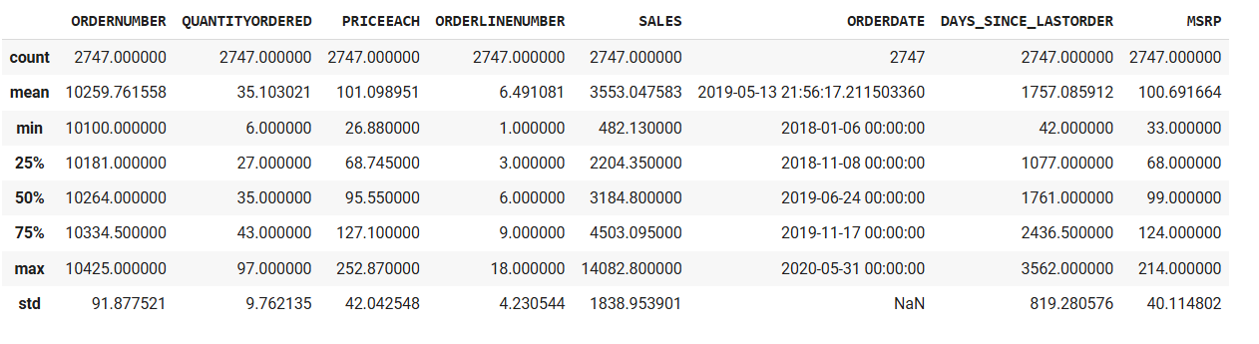
Statistical Summary
Inference :
The average number of items ordered per sales order is 35, with a standard deviation of 9.76.
The average price of each item is 101.09, with a standard deviation of 42.04.
The average sales amount per order is 3553.05, with a standard deviation of 1838.95.
The average time since the last order is 1757.09 days, with a standard deviation of 819.28.
The summary statistics do not indicate any red flags or abnormalities that could potentially indicate issues with the data.

Slide 10
Exploratory Analysis & Insights
Univariate, Bivariate, and multivariate analysis using data visualization
Weekly, Monthly, Quarterly, Yearly Trends in Sales
Sales Across different Categories of different features in the given data
Summarize the inferences from the above analysis

Slide 11
UNIVARIATE ANALYSIS

Slide 12
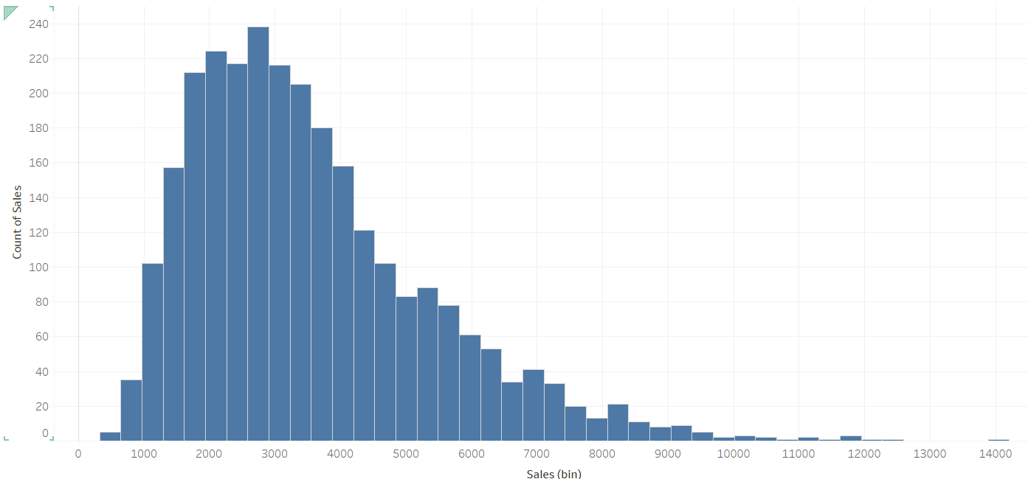
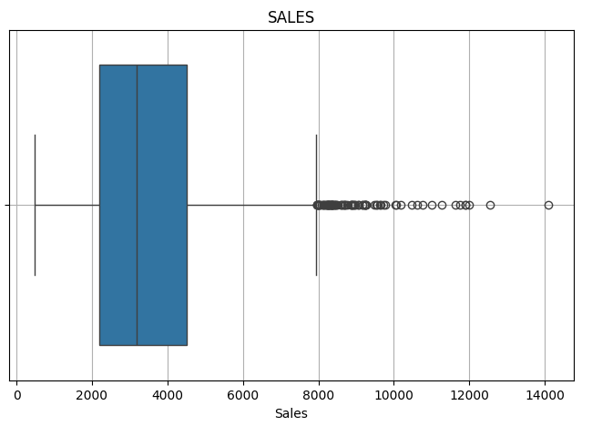
SALES
We can see that sales data is skewed toward left.
There are many outliers.
Most data exist between 1.5k - 3.5k.

Slide 13
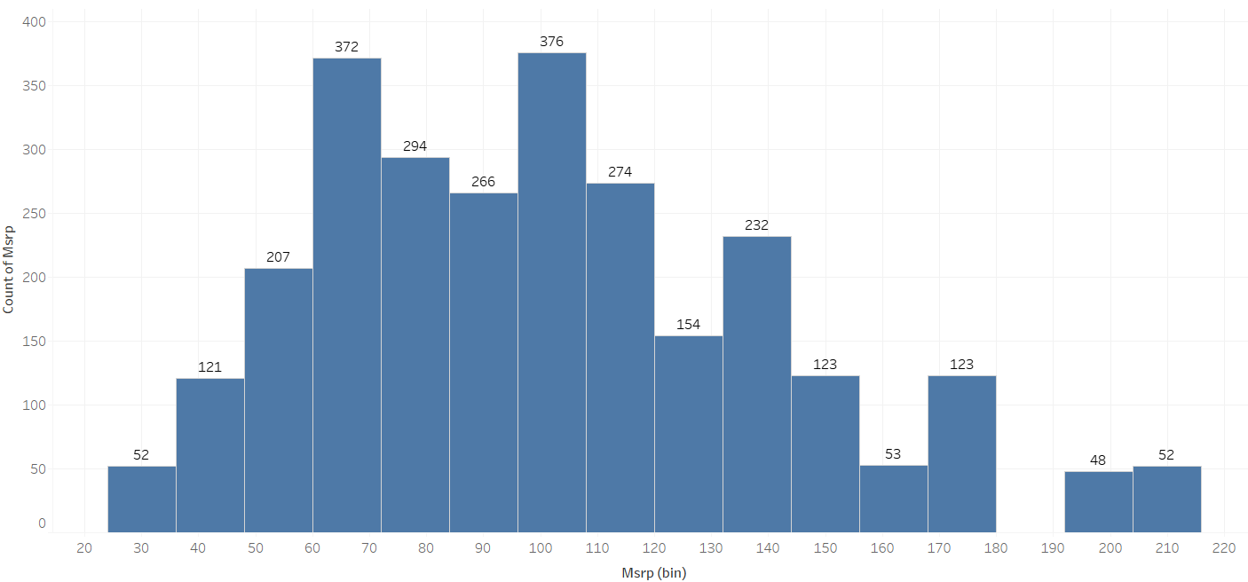
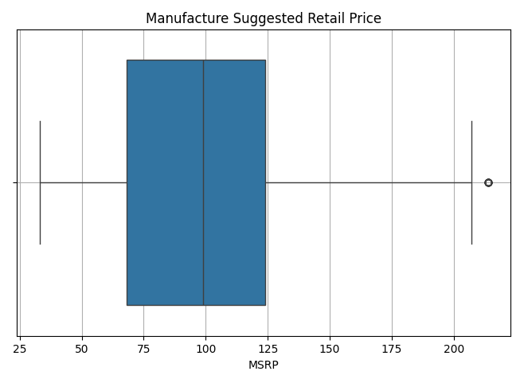
MRSP
Outlier are present in the MRSP Data
This data is shewed toward left

Slide 14
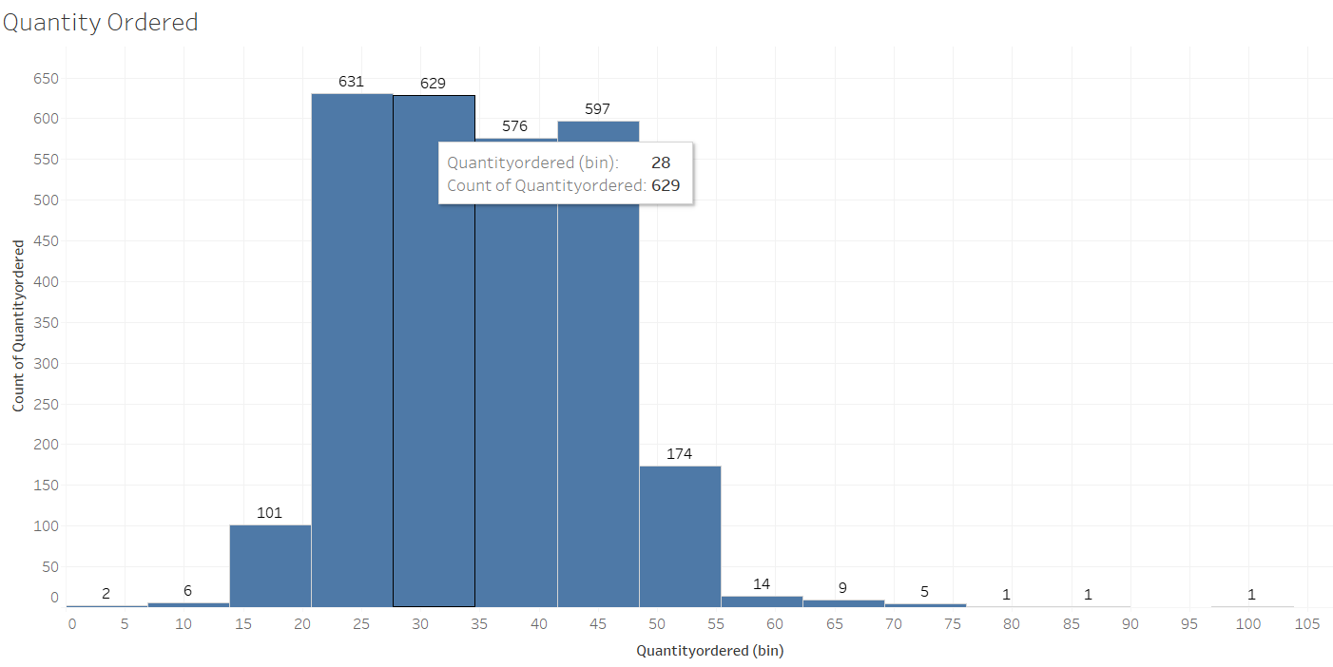
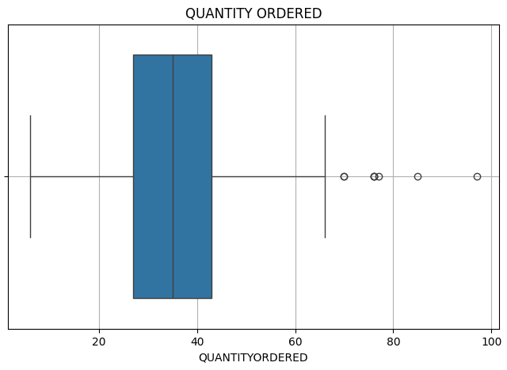
Quantity Ordered
Outliers are present in the data of Quantity Ordered.

Slide 15
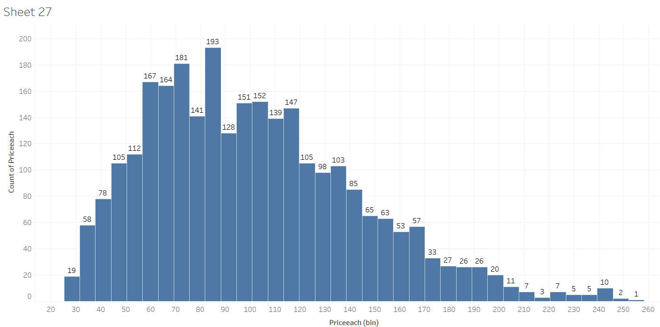
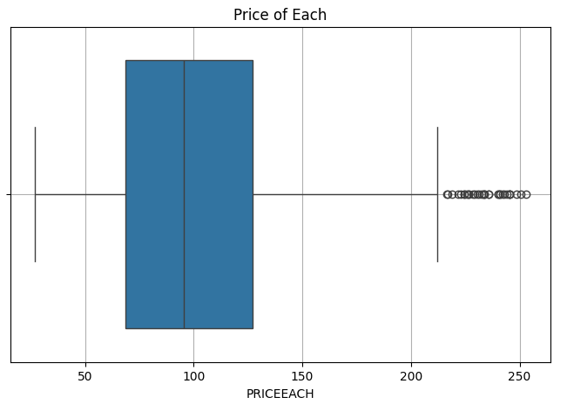
Slightly right skewed but with many outliers
Price of each item

Slide 16
Slightly right skewed but with many outliers
Price of each item

Slide 17
BIVARIATE ANALYSIS

Slide 18
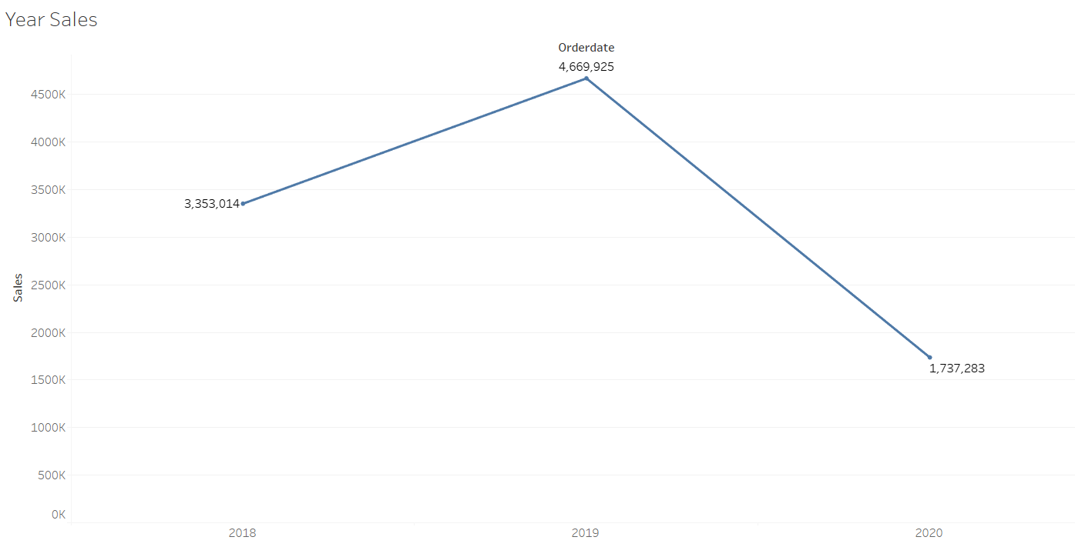
We can see that there is a dip in the yearly sales
We need to find more information regarding this as its not a good sign.
Yearly Sales

Slide 19
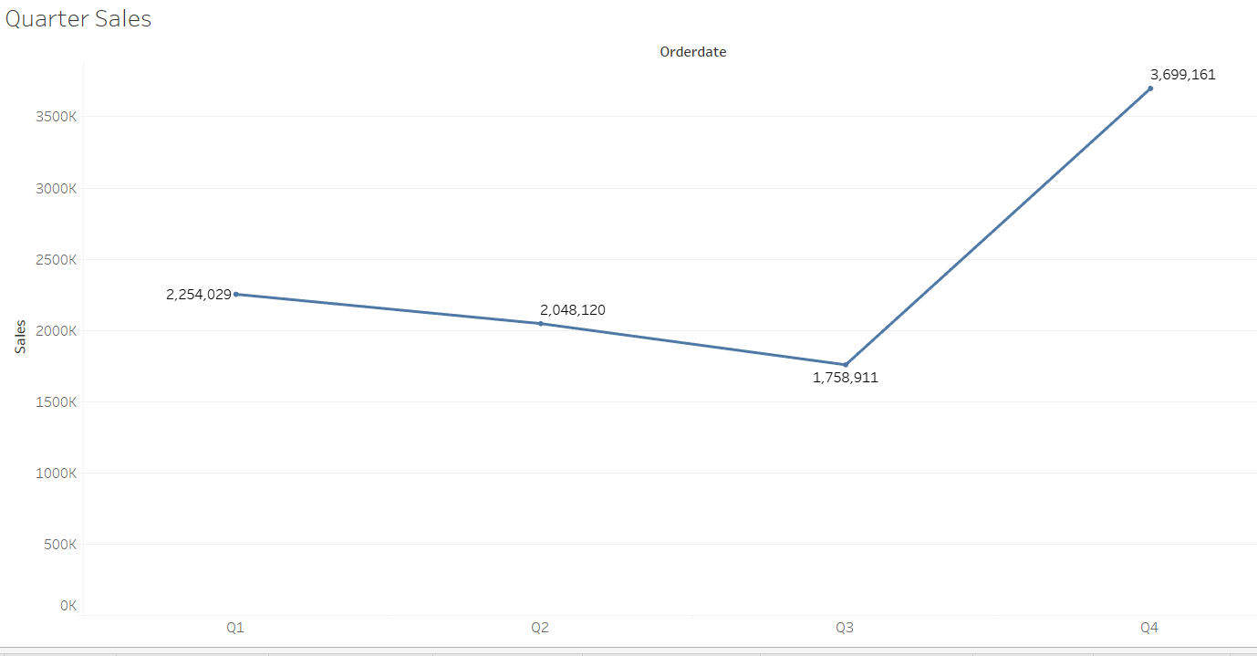
We can see that in the quarter 4 there is high sales as compared to other quarters.
Quarterly Sales

Slide 20
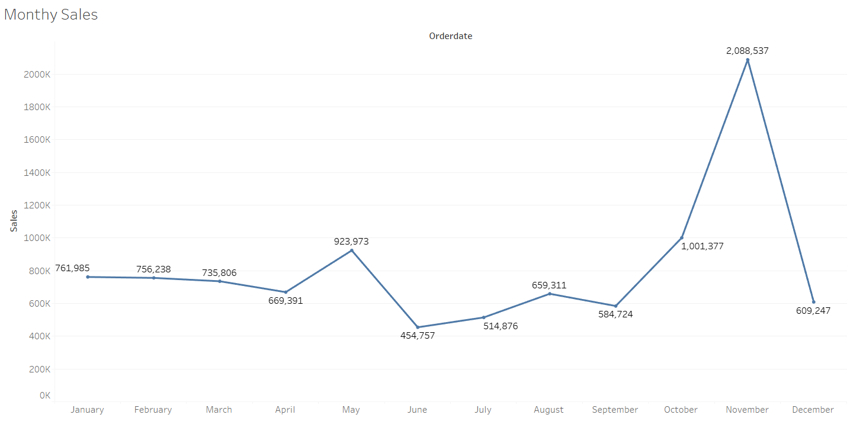
We can see that in the 11th month there is highest sales.
And in 6th month the sales is the lowest.
Sales is consistent in the first 4 months of the year
Monthly Sales

Slide 21
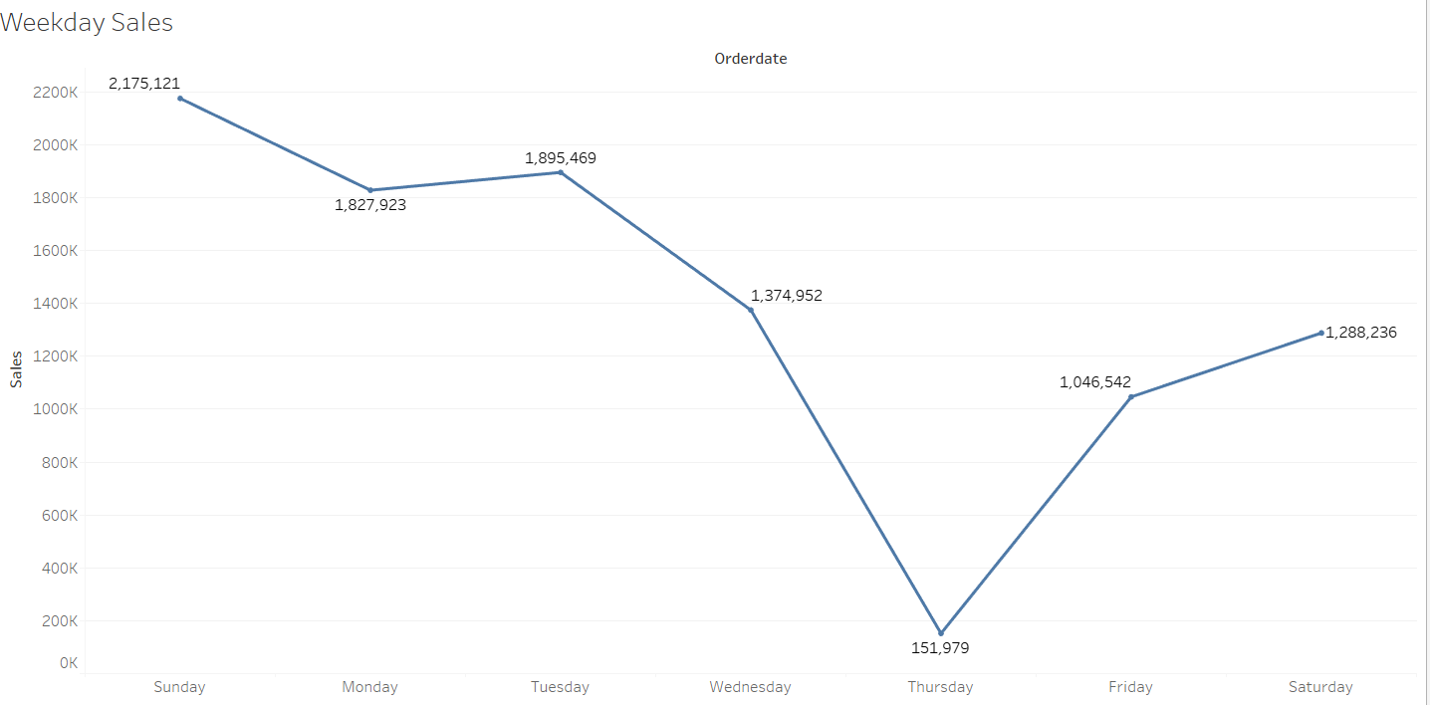
We can see Thursday has the lowest sales and Sunday has the highest sales.
Sales increases from Friday to Sunday and dips from Monday to Thursday
Weekdays Sales

Slide 22
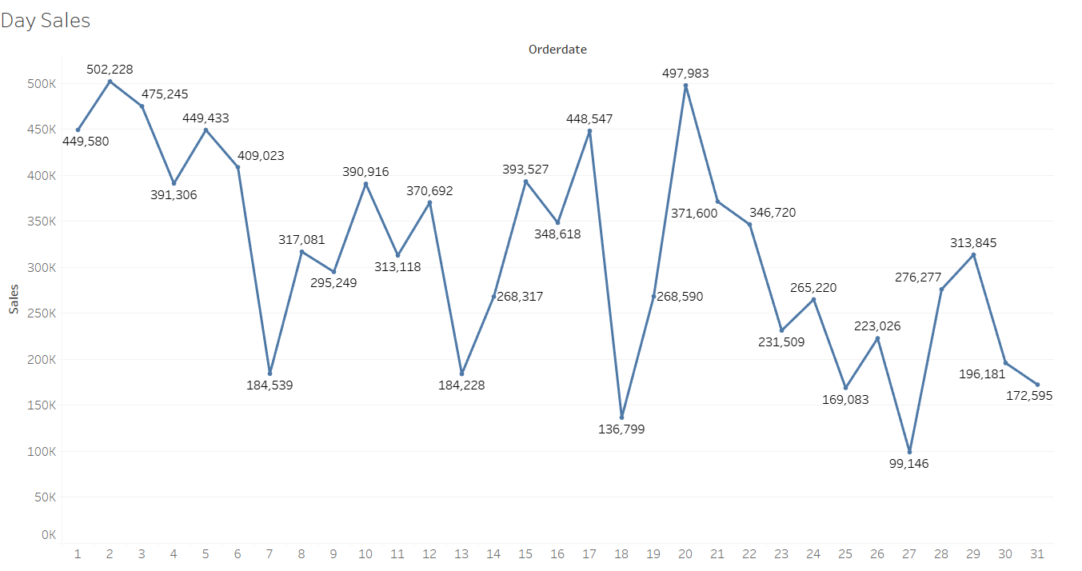
Day Sales
In the stating days of month there is more sales as compared to the end days.

Slide 23
MULTIVARIATE ANALYSIS

Slide 24
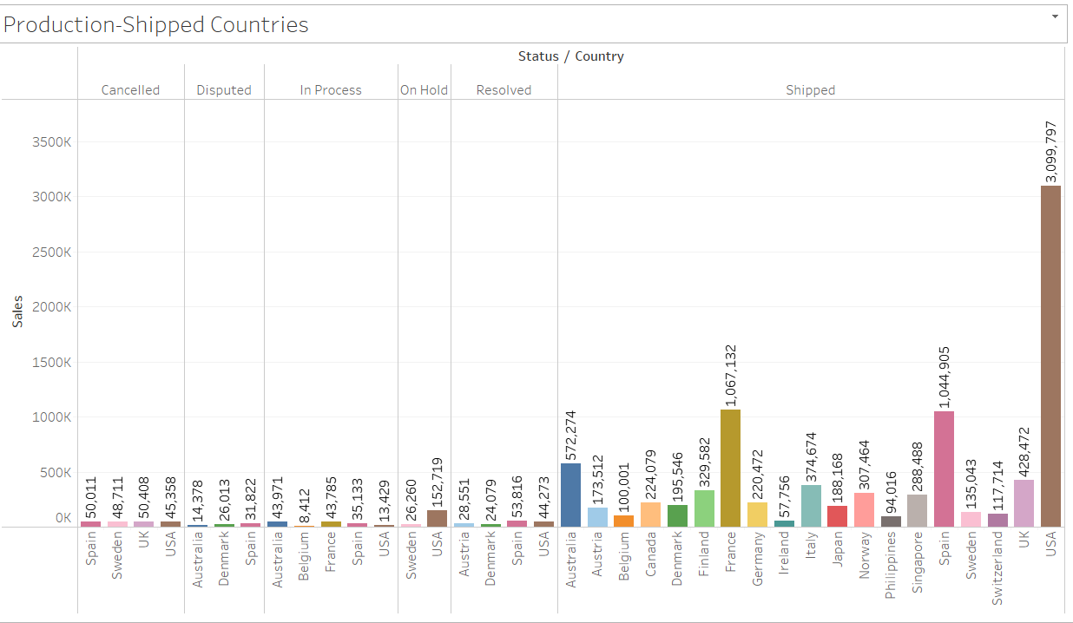
We can see most of the orders which are on hold belongs to USA, some orders on hold belong to Sweden.
UK, USA, Spain, Sweden have approx. same number of canceled orders.
Spain has most disputes and also most disputes are solved.
Status, Country & Sales

Slide 25
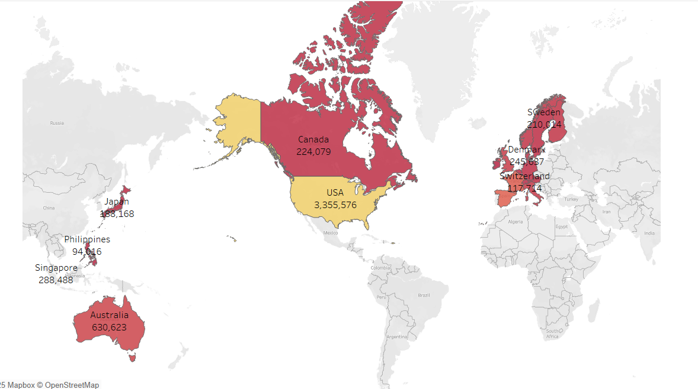
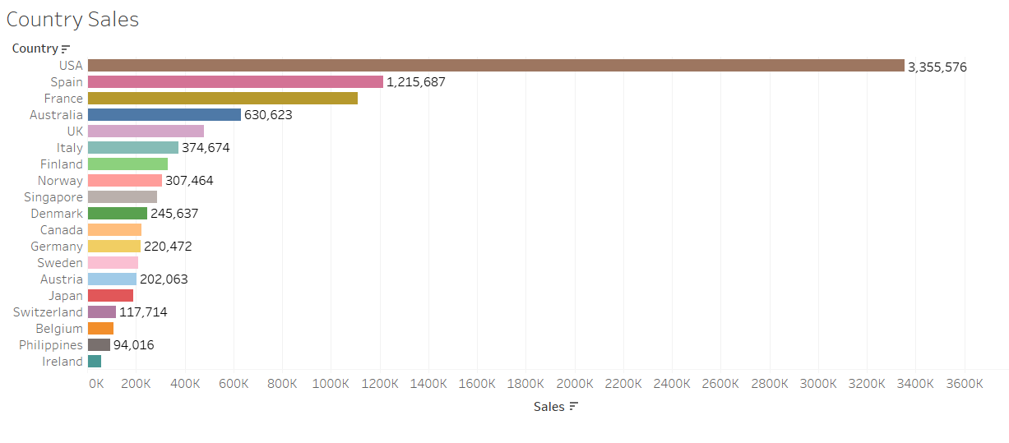
Usa has most shipped orders.
Spain and France have approx same number of orders.
Ireland have the least number of orders shipped
Order Shipped & Sales

Slide 26
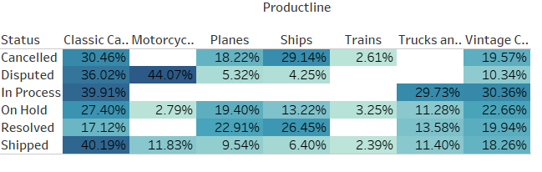
Most people deal parts of classic car as it has the higher %.
Parts of motorcycles are the most Disputed category.
Least people deal with Train parts.
Pivot Table

Slide 27
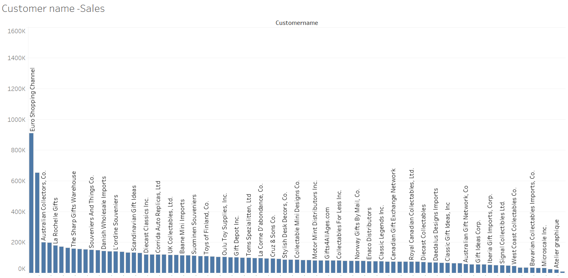
Sales & Customer names
Euro Shopping Channel has Highest sales.

Slide 28
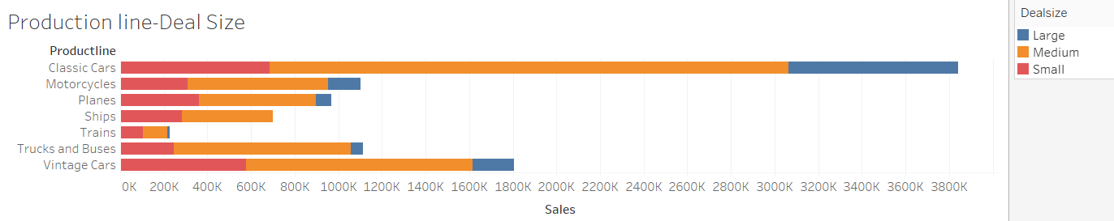
Most sales: Classic cars
Least sales: Trains
Most Deal size: medium
Least Deal size: large
Sales of truck and buses and motorcycle are approx. same
Sales & Deal Size

Slide 29
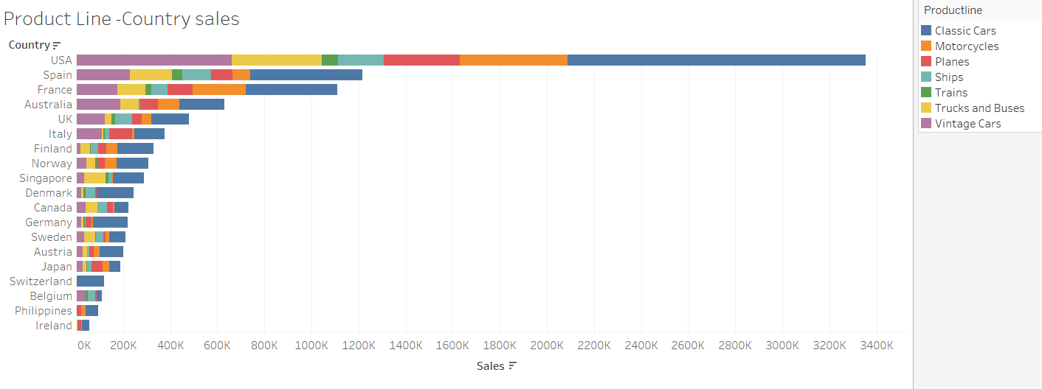
The USA dominates sales, particularly in the "Classic Cars" category, while other countries show varying sales performance across different product lines.
European markets like Spain and France have strong sales, though lower than the US, and several countries show considerably lower overall sales.
Product Line Sales Insights

Slide 30
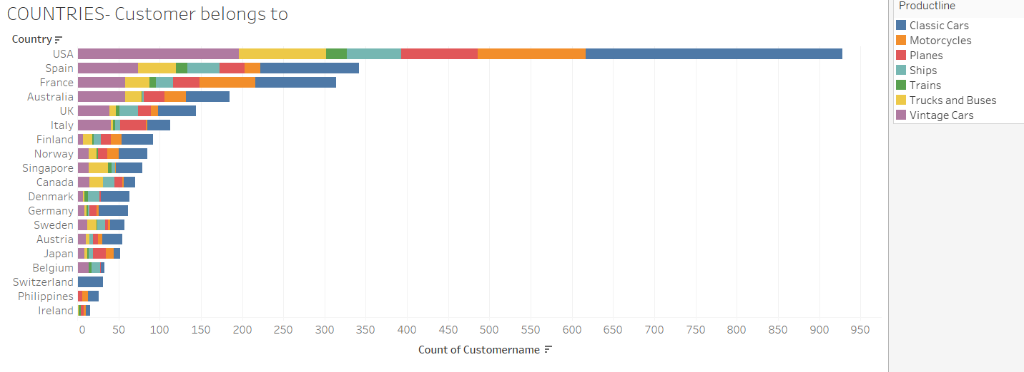
The USA has the highest count of customers across most product lines, especially Classic Cars, while other countries have fewer customers and a different distribution of product line interest.
Customer & their country

Slide 31
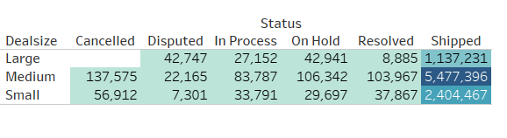
Status, Sales and Deal Size
No order of large deal type is cancelled it’s a good sign.
Most shipped parts belong to medium deal size type.

Slide 32
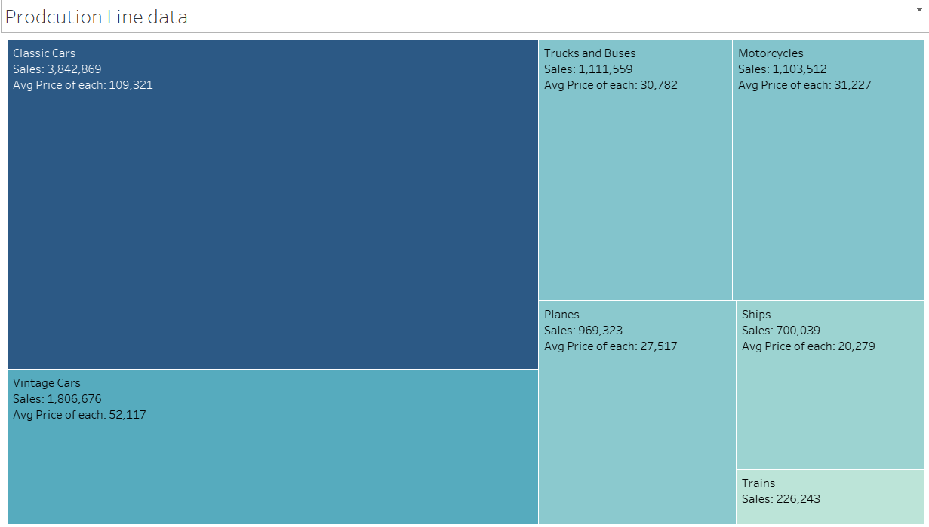
PRODUCT LINE AND SALES
Classic Cars generate the highest sales and have the highest average price, while Trains have the lowest sales.

Slide 33

SALES-DASHBOARD

Slide 34
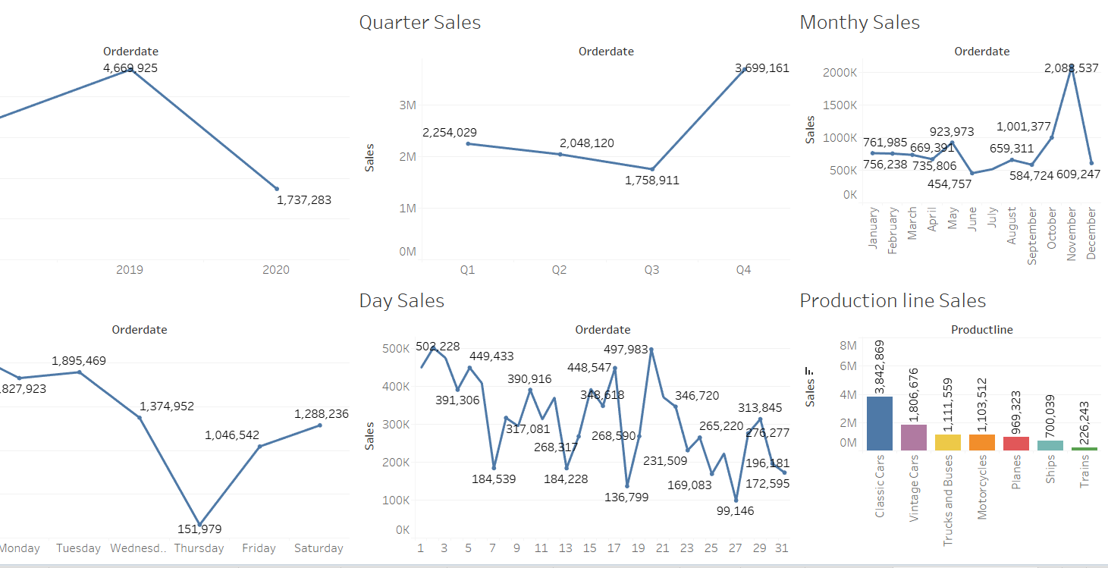

Slide 35
INFERENCES
The yearly sales have dipped, which is not a good sign.
Quarter 4 has higher sales compared to other quarters.
Sales are consistent in the first 4 months of the year.
Thursday has the lowest sales, and Sunday has the highest sales.
Sales increase from Friday to Sunday and dip from Monday to Thursday.
In the starting days of the month, there are more sales than the end days.
Most orders on hold belong to the USA, and some belong to Sweden.
Spain, USA, UK, and Sweden have approximately the same number of canceled orders.
Spain has the most disputes, and most disputes are solved.
Classic car parts have the highest percentage of sales.

Slide 36
RECOMMENDATIONS
Further investigation is necessary to identify the reasons for the dip in yearly sales.
To capitalize on the high sales in quarter 4, businesses should focus on increasing their inventory during this period.
Businesses should identify the reasons behind the low sales in the 6th month and work towards addressing them.
Businesses should focus their marketing efforts on Thursdays to improve sales on this day.
Strategies such as weekend sales can be employed to increase sales from Friday to Sunday.
Businesses should consider offering discounts or promotions during the start of the month to increase sales.
Efforts should be made to resolve the orders on hold to prevent revenue loss.
Businesses should monitor canceled orders closely and identify any trends to address them.
Steps should be taken to resolve disputes quickly and efficiently to maintain customer satisfaction.
Businesses should consider expanding their inventory of classic car parts, given their high sales percentage.

Slide 37
Customer Segmentation using RFM analysis
What is RFM and which tool used
What all parameters used and assumptions made
Output table head
Workflow image to be put when KNIME used

Slide 38
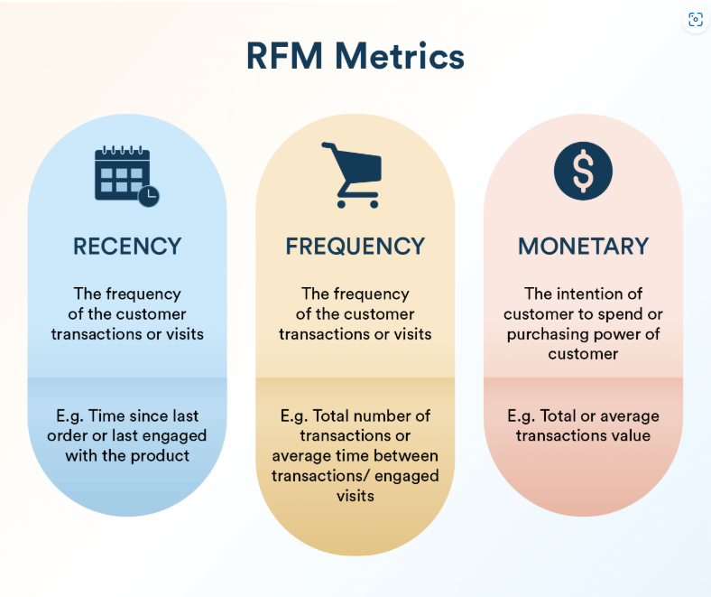
What is RFM ?
RFM (Recency, Frequency, Monetary) Analysis
RFM is a marketing technique used to identify the most valuable customers based on their purchasing behavior.
It scores customers in three key areas:
Recency – How recently a customer made a purchase
Frequency – How often they make purchases
Monetary – How much they spend in total

Slide 39

Tool used : KNIME
KNIME, the Konstanz Information Miner, is a free and open-source data analytics, reporting and integration platform.

Slide 40
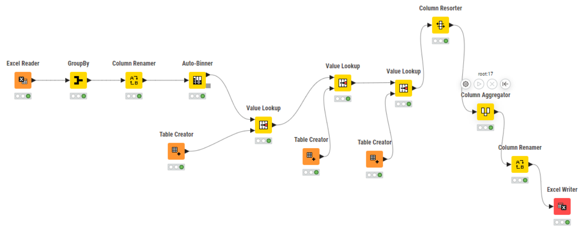
WORKFLOWS
This workflow calculates RFM (Recency, Frequency, Monetary) values to analyze customer behavior. It reads transaction data, groups it by customer to determine Recency (using the most recent order date), Frequency (using order counts), and Monetary value (using total sales). These RFM values are then binned, scored, and combined to produce a final RFM score for each customer, enabling customer segmentation.

Slide 41
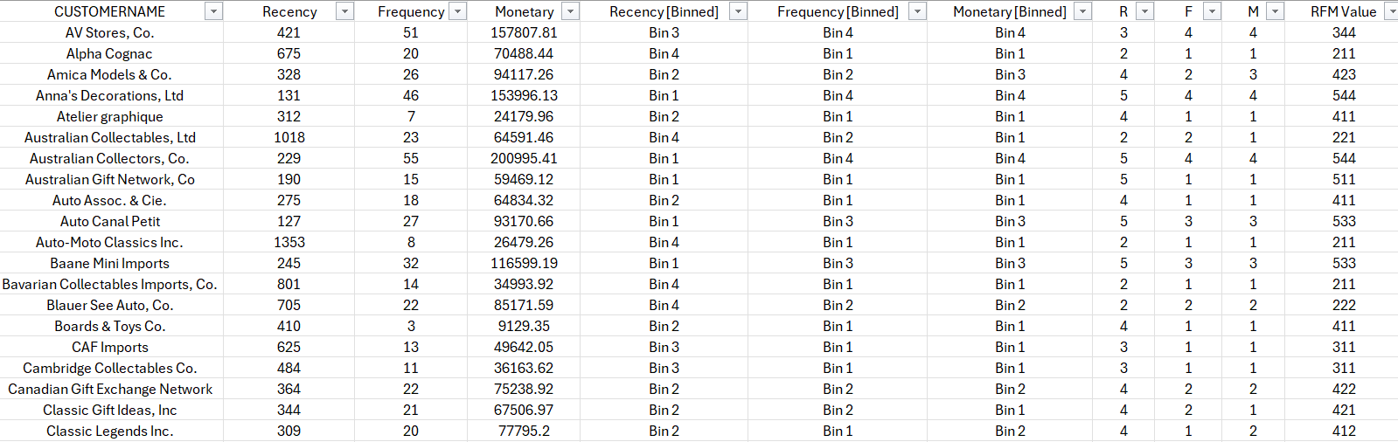
Few rows of output

Slide 42
Inferences from RFM Analysis and identified segments
Who are your best customers?
Which customers are on the verge of churning?
Who are your lost customers?
Who are your loyal customers?

Slide 43
Top 5 best customers
According to RFM score we have grouped the top customers.
We have given importance to recency more and ordered the customers accordingly.

Slide 44
Top loyal customers
Based on RFM analysis these are the loyal customers
We have focused on monetary value
If we focus on these customer’s we can turn them into best customers.

Slide 45
Verge on churning Customers
As per RFM score we can see that these are the top customers on the verge of churning.
We should focus on these customers before we lose them.
We should try some action plan to convert them into regular customers.

Slide 46
Top Lost Customers
As per RFM score we can see that these are the customers which we have lost.
There recency is very low as well as they have not made purchase frequently.
We should study them survey them to understand the reasons why we lost them. And take further steps so that we do not lose the customers.

Slide 47
RECOMMENDATIONS

Slide 48
Recommendations
Based on the RFM analysis, customers can be grouped into four categories: Best, Loyal, At Risk (Verge of Churn), and Lost. Each group requires a tailored strategy to enhance engagement and improve retention.
Best Customers: Offer personalized recognition, exclusive deals, and loyalty rewards to maintain their interest and long-term relationship with the brand.
Loyal Customers: Keep them engaged with regular offers and discounts. With the right incentives, they can be nurtured into best customers.
At Risk Customers: These customers show signs of leaving. Use feedback surveys, targeted offers, and personalized outreach to address their issues and rebuild loyalty.
Lost Customers: Analyze their past behavior to understand why they left. Use these insights to build strategies that prevent future churn and enhance customer satisfaction.

Slide 49
THANKYOU

